Slide 1
Patient-specific Optimization of a Neurosurgical Robotic Manipulator
Michael Brauckmann – Daniel Miller 4/29/14

Slide 2
Overview
Problem Description
Genetic Simulation Overview
Robot Description
Parameterization of Linkage
Forward and Inverse Kinematics
Linkage Evaluation
Fitness Function
Collision Detection
Results
Future Work

Slide 3
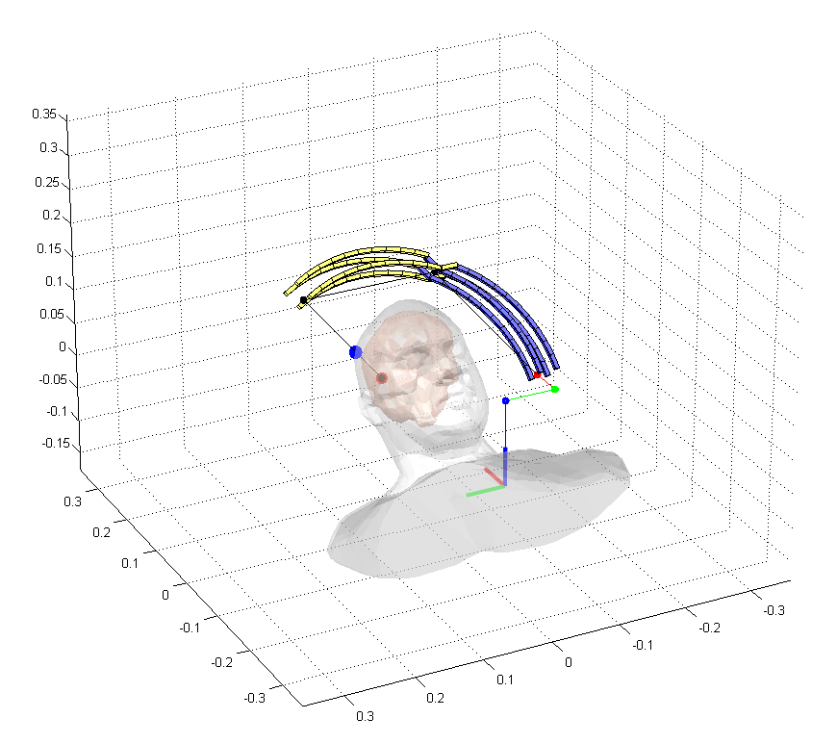
Problem Description
Optimize the robot’s geometry
To the patient’s dimensions
To the surgical site
To the surgical workspace
Avoid collisions
Patient & MRI Machine
Other possible subtasks
Maximize clearance
Maximize rigidity
…
The AIM Lab RCM Robotic Manipulator

Slide 4
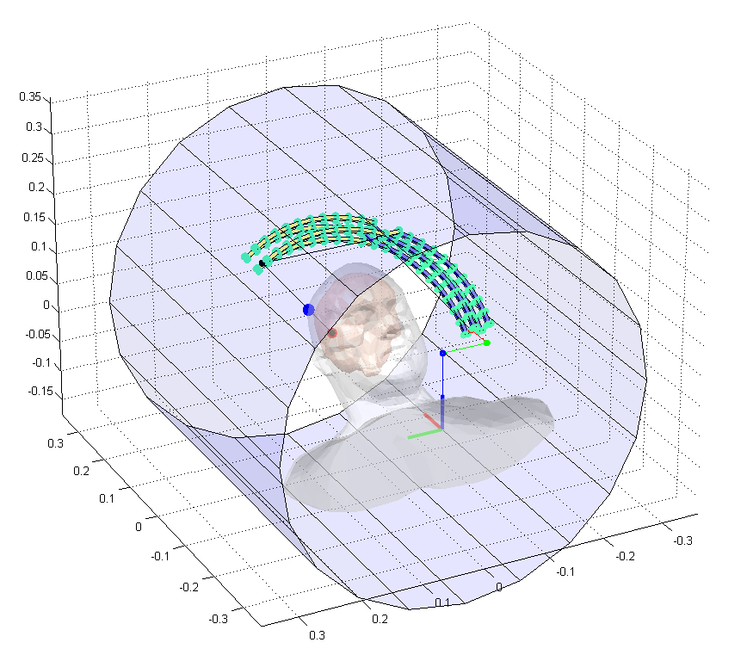
Problem Description
Optimize the robot’s geometry
To the patient’s dimensions
To the surgical site
To the surgical workspace
Avoid collisions
Patient & MRI Machine
Other possible subtasks
Maximize clearance
Maximize rigidity
…
The AIM Lab RCM Robotic Manipulator

Slide 5
Genetic Simulation Overview
Motivation
Genetic Algorithms
Complex non-linear parameter space
Small change in linkage dimension may result in inadmissible configuration (i.e Collision)
No quantitate way to compare configurations (yet.)
Generate a “population” of varying linkages
Evaluate each linkage against a particular task
Weight performance in different categories
Select high-performing individuals
Proportional to performance
Mutate members of population
Crossover
Random mutation
Repeat

Slide 6
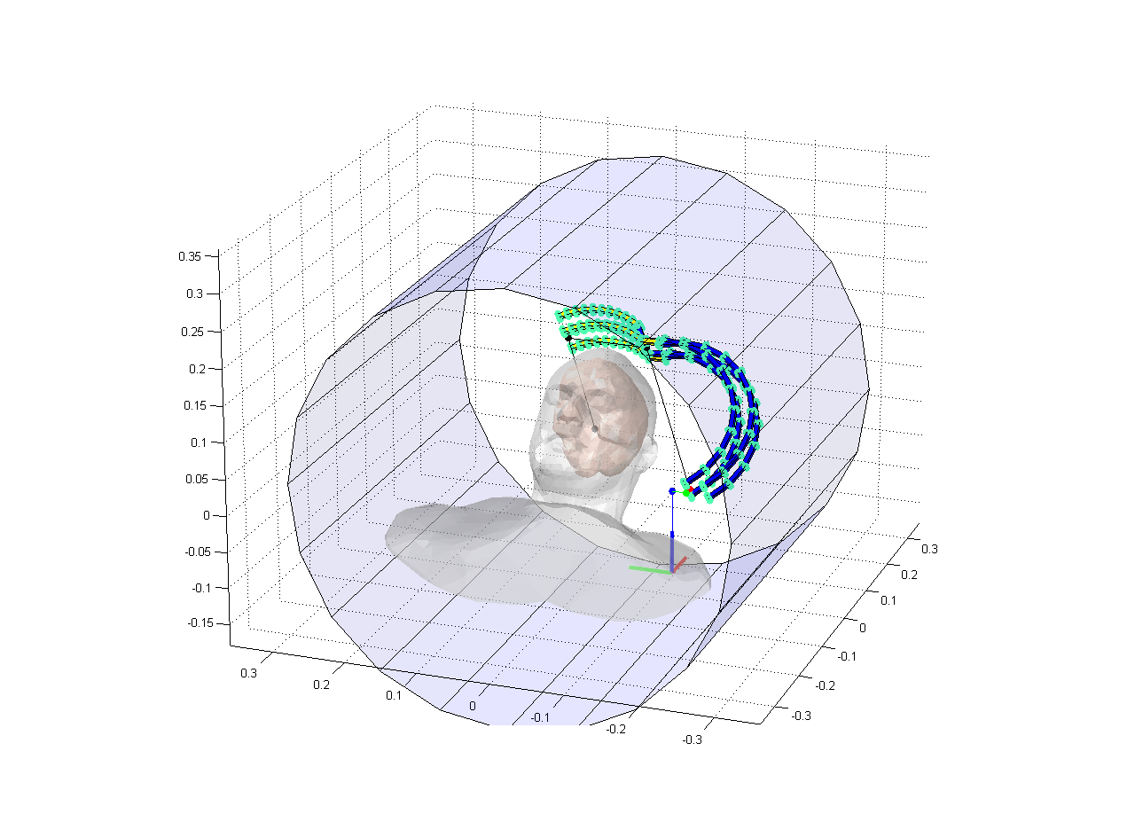
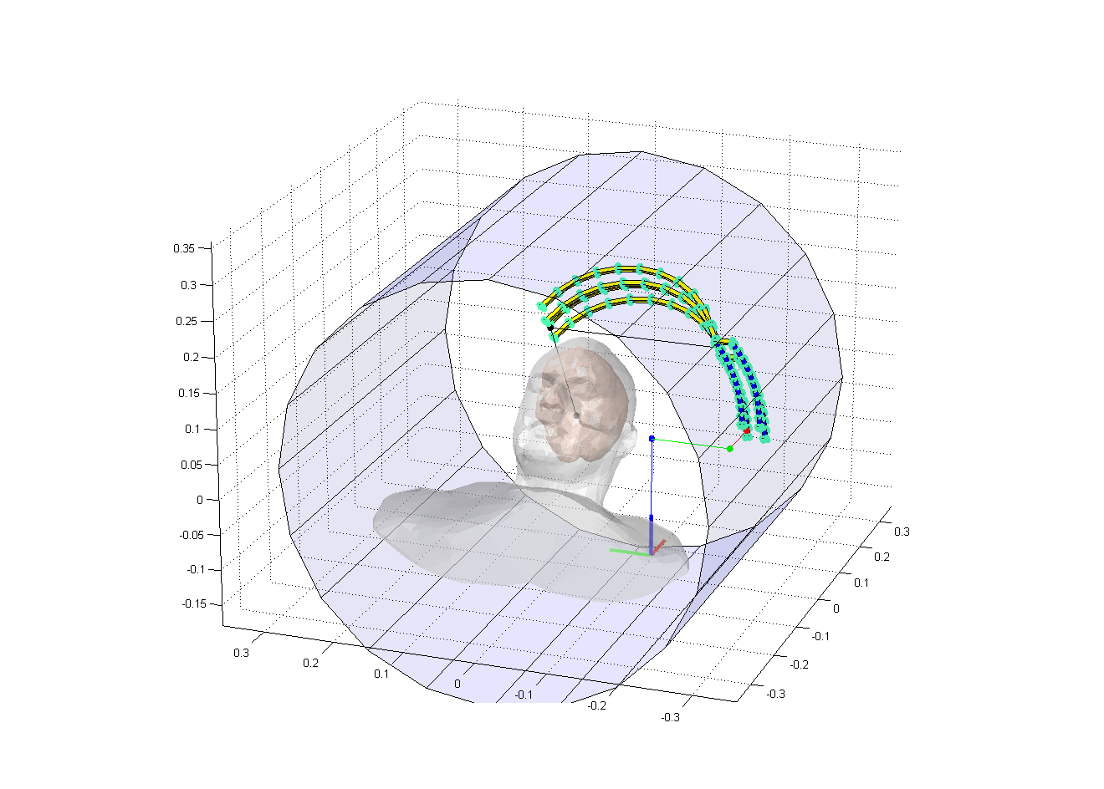
Robot Description
3 Rotational & 4 Translational joints
Linkage rotates about point relative to base
Linkage Parameters:
Link 1 – Length
Link 1 - Radius
Link 2 – Length
Link 2 – Radius

Slide 7
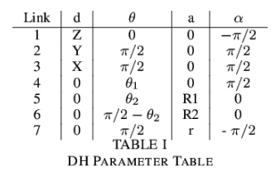
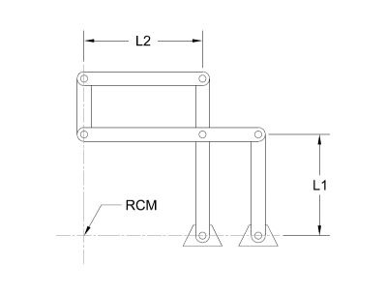
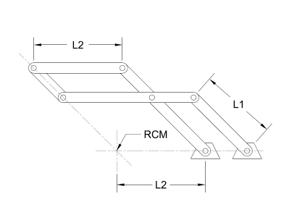
Forward and Inverse Kinematics
Forward Kinematics
Kinematics determined by with Denavit-Hartenburg parameters
Resulting linkage motions rotate about a fixed point
Location of fixed point determined by location of XYZ Table

Slide 8
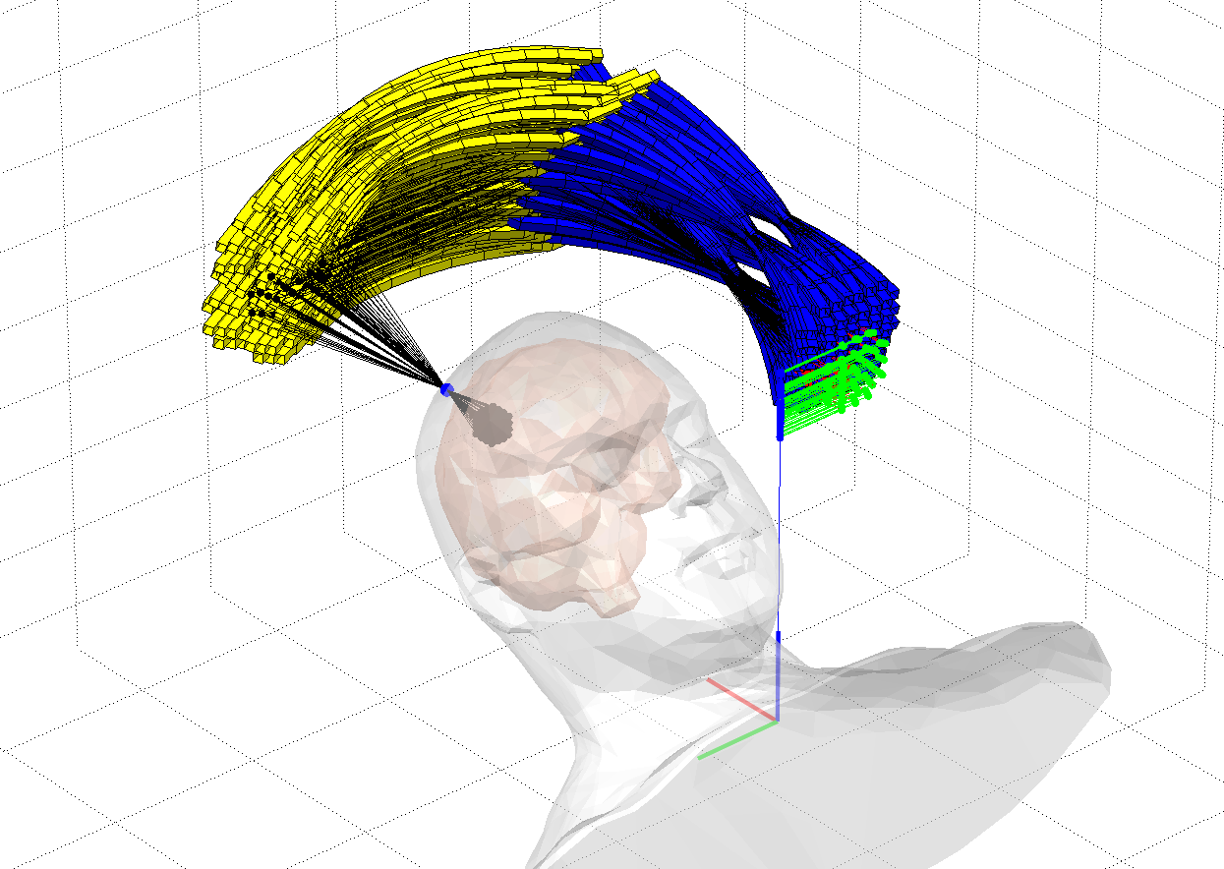
Forward and Inverse Kinematics
Inverse Kinematics
Given the point of entry a geometrical solution is easy
The two angles are defined by the 3D slope of the line from entry point to goal
The XYZ Table must Lie on a parallel Line
This line can be parameterized by the needle extension to give an exact point

Slide 9
Linkage Evaluation Fitness Function
Test Parameters
Other Possibilities
Percentage of IK solutions that collided
Percentage of Workspace with at least one none colliding solution
Percentage of IK solutions not in bounds of XYZ table
One over the total Link Length
Short links are stiffer and more accurate
Median extension of needle
keeping it near middle of range tend to increase distance from collision
Average distance of a point to nearest obstacle
Good for collision avoidance

Slide 10
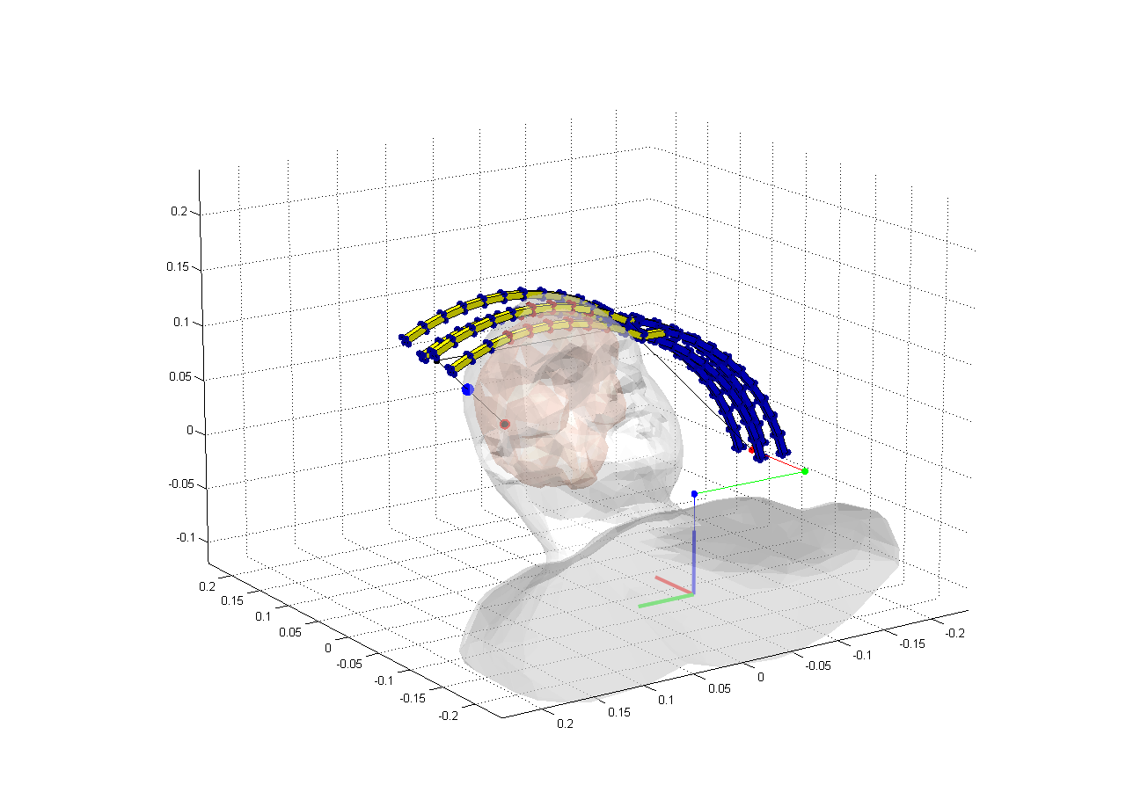
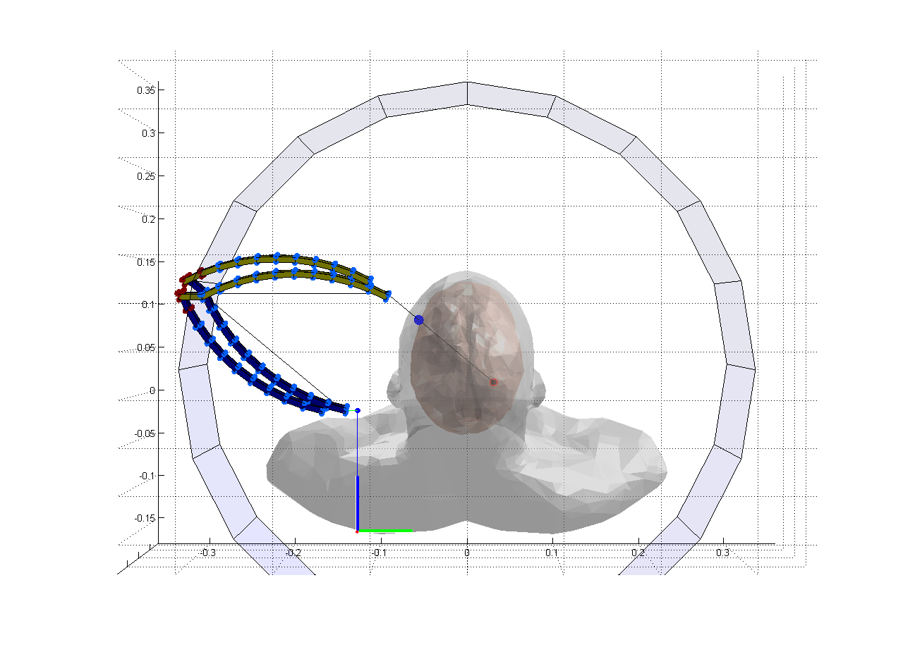
Linkage Evaluation Collision Detection
Collisions approximated with shape primitives
Shape collision trivial to calculate
Concave Mesh collision very difficult to calculate
Collision with patient
Approximated as set of Spheres
Collision with MRI bore
Approximated as Cylinder

Slide 11
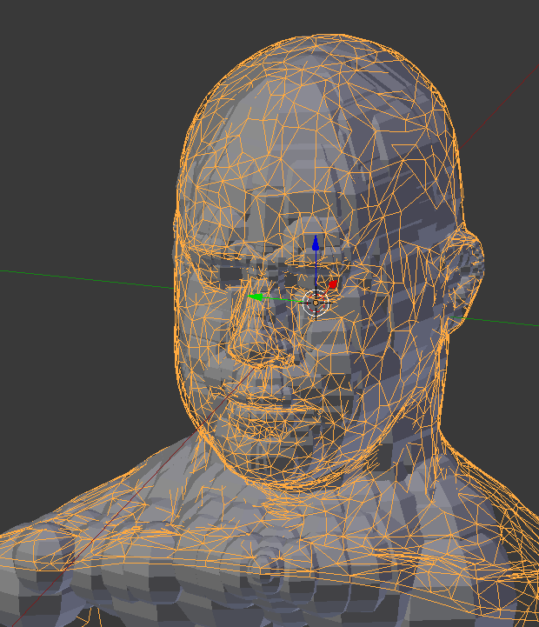
Linkage Evaluation Collision Detection
Collisions approximated with shape primitives
Shape collision trivial to calculate
Concave Mesh collision very difficult to calculate
Collision with patient
Approximated as set of Spheres
Collision with MRI bore
Approximated as Cylinder

Slide 12
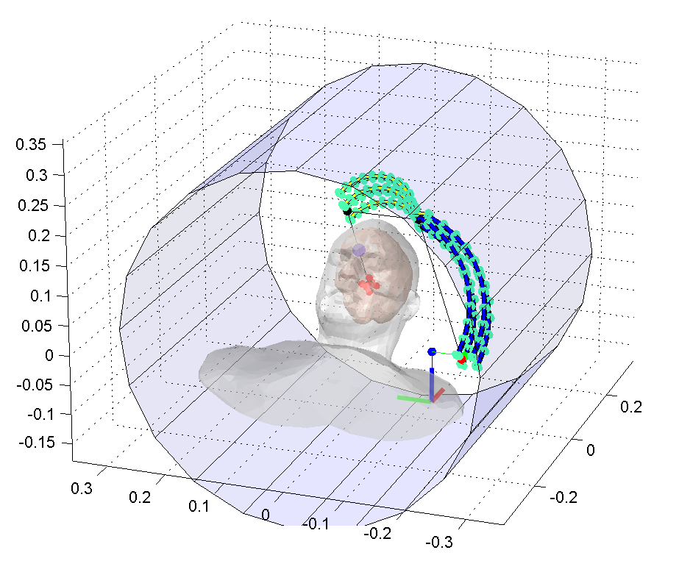
Results!
Successfully generated viable linkages through genetic simulation
Created a fast collision detection approximation
Resolved redundancy in manipulator

Slide 13
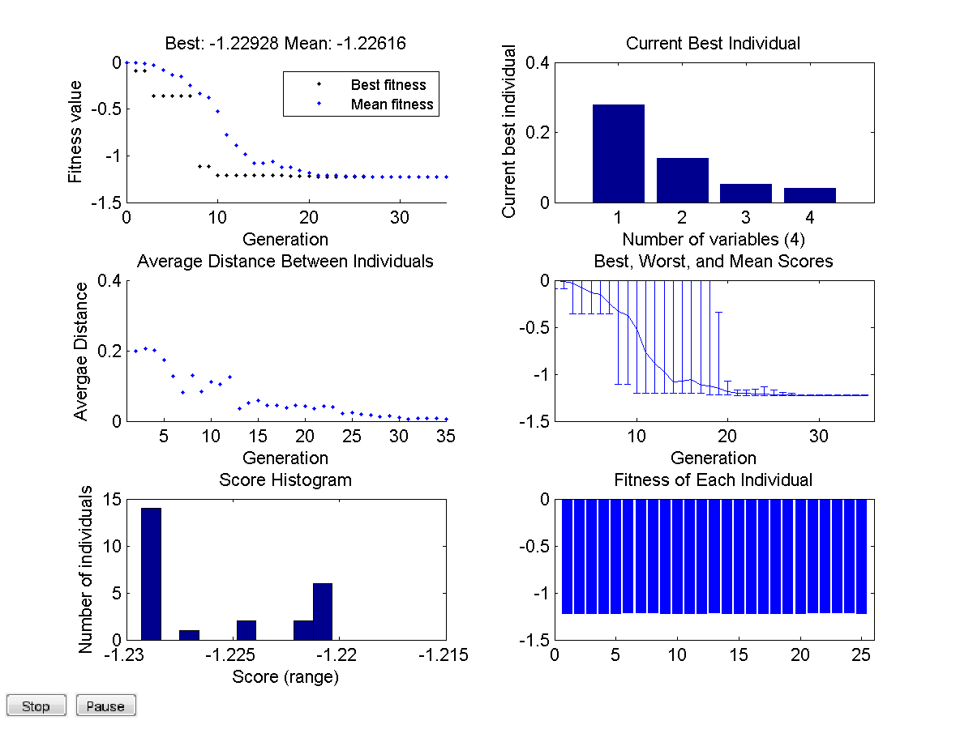
Results!
Successfully generated viable linkages through genetic simulation
Created a fast collision detection approximation
Resolved redundancy in manipulator

Slide 14
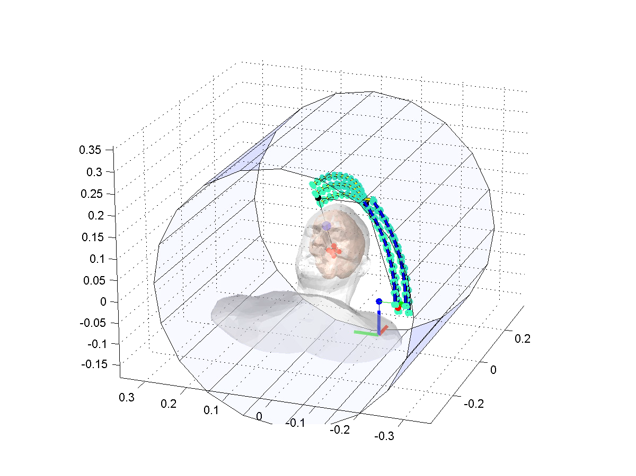
Results!

Slide 15
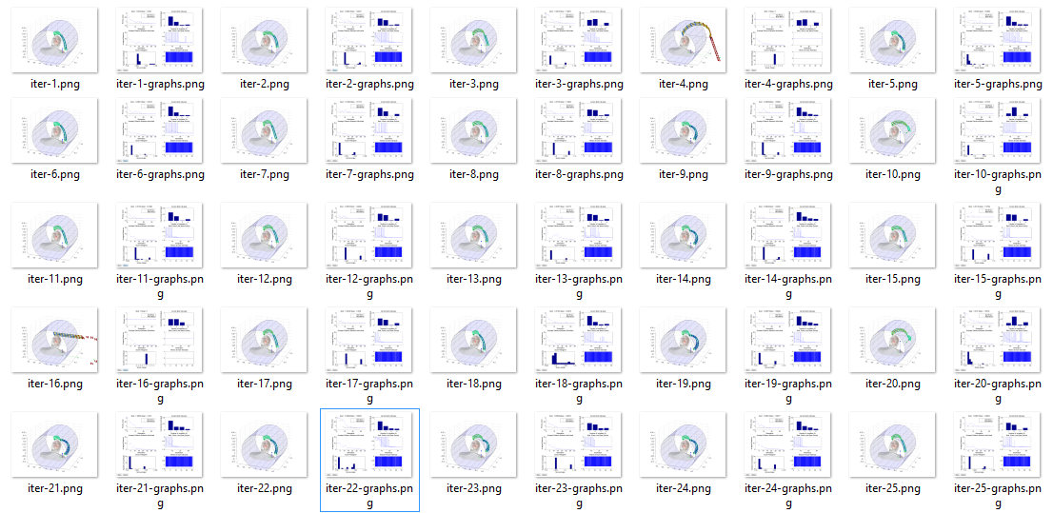
Thank you! Any questions?

